Slide 1
Intro to Computer Science
MIT WTP 2022

Slide 2
What is computer science?
Using computers as a tool to solve other problems
Finding optimal solutions to problems
Thinking about what kinds of problems are hard for computers and why
Figuring out ways to improve people’s lives using computers
“Computer science is no more about computers than astronomy is about telescopes” – E.W. Dijkstra
Notes:
Ok thank you university of Maryland but what in the world does that entail?

Slide 3





What can you do with computer science?

Slide 4
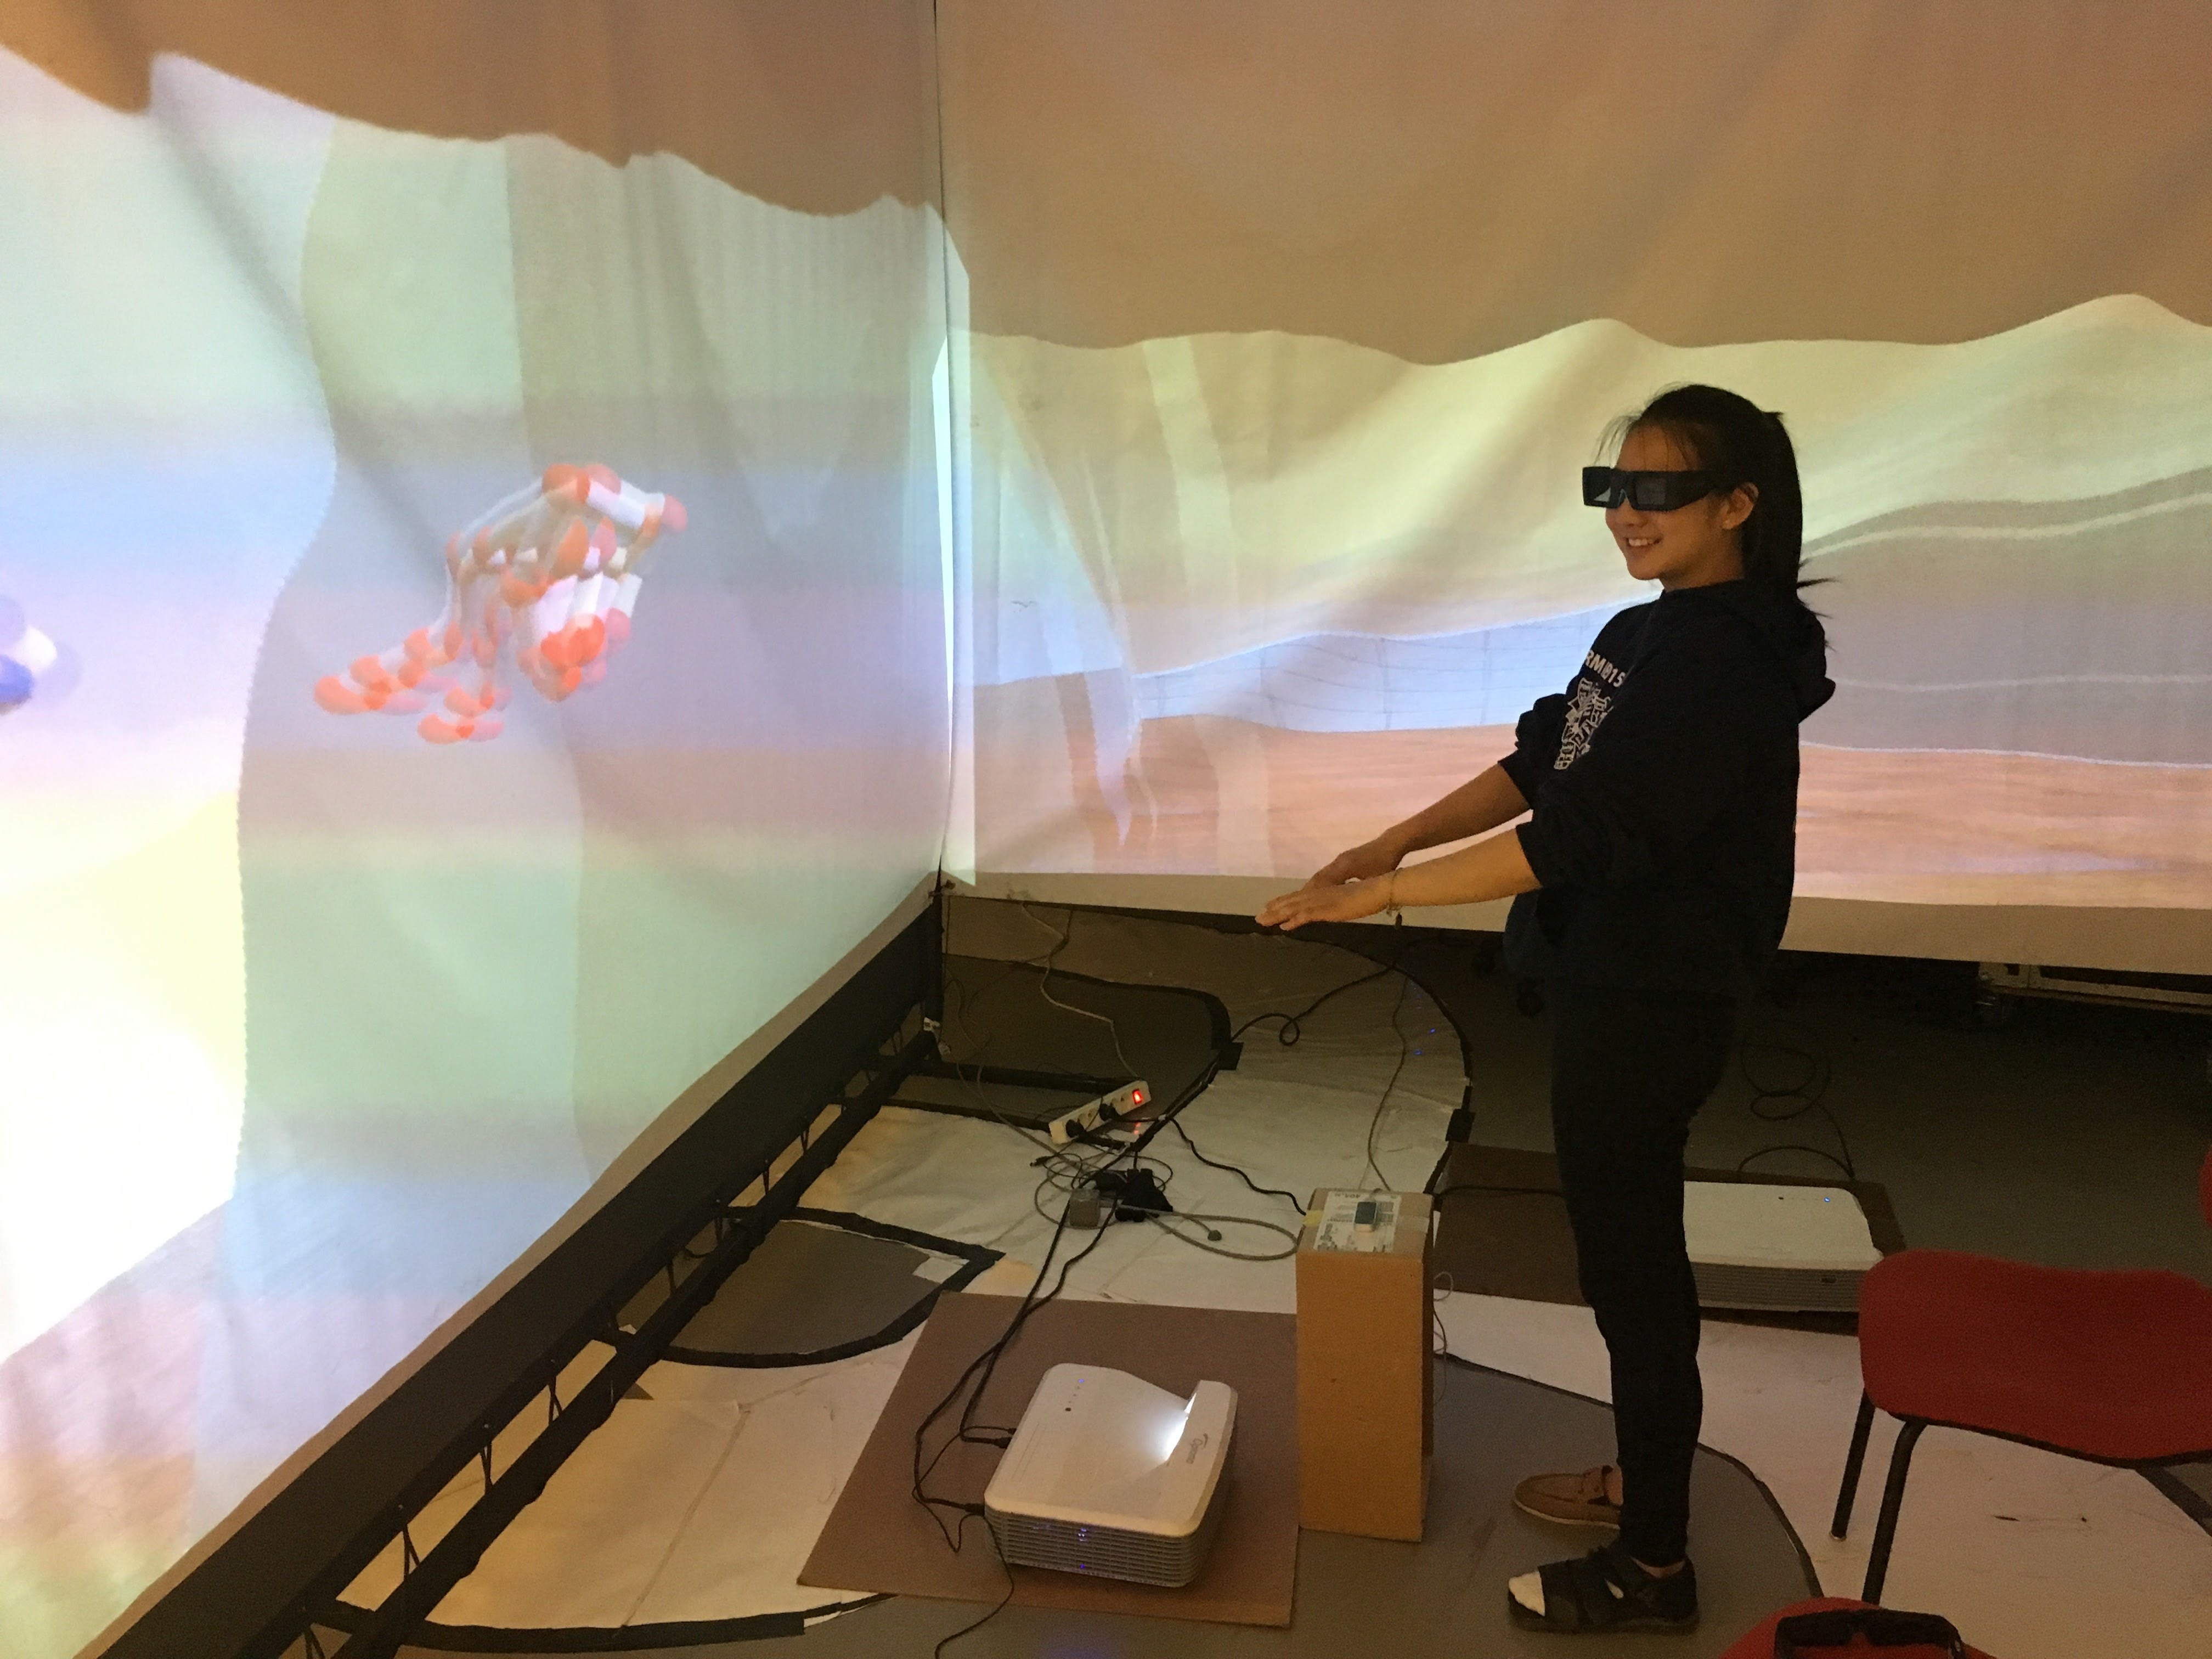
What have I worked on?
SUMMER 2016
ESIEE Paris
Built a 3D virtual tour of the building I worked in!

Slide 5
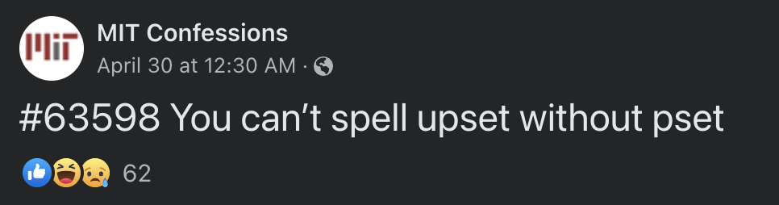
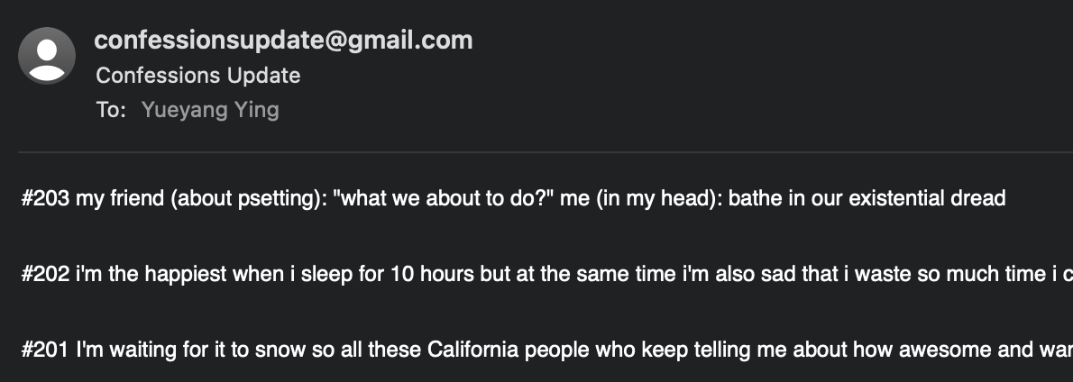
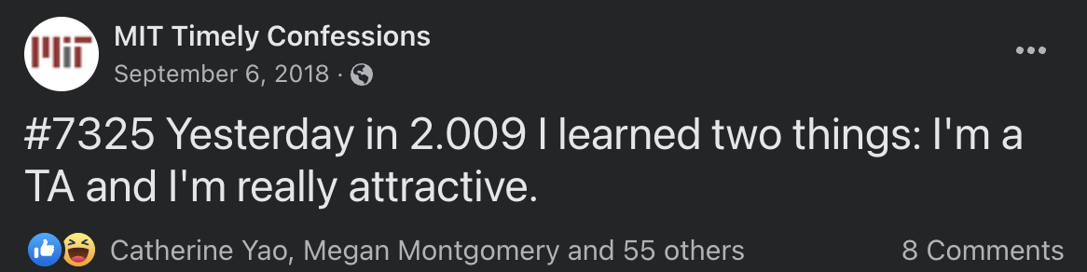
What have I worked on?
FALL 2016
MIT Confessions Scraper

Slide 6

What have I worked on?
2020-2022
MIT/CERN

Slide 7
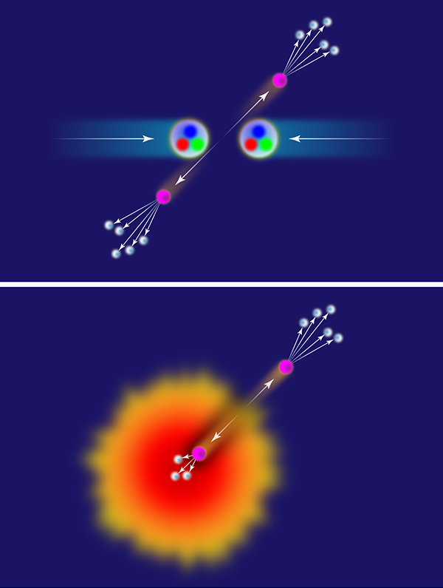
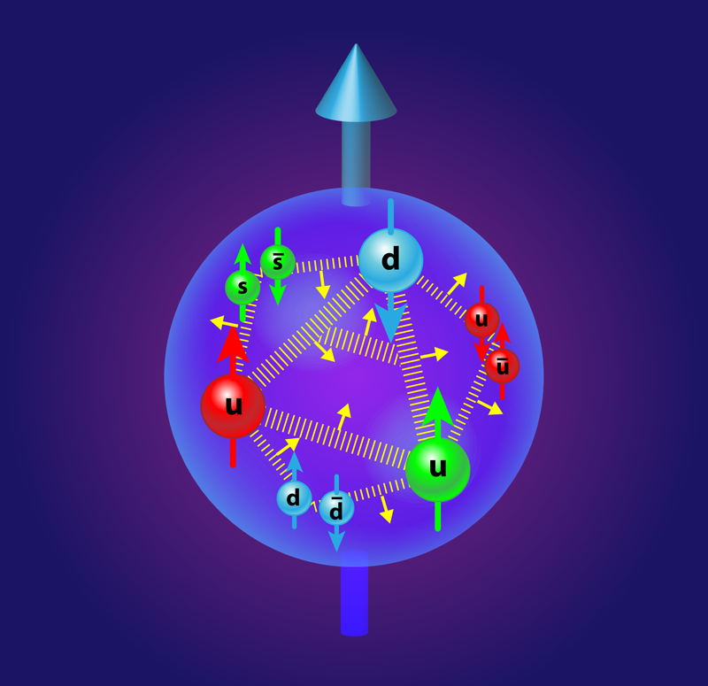
What have I worked on?
2020-2022
MIT/CERN
Collision “kicks out” particle from the nuclei, which produces a jet
Quarks
Gluons
Lead-lead collisions produce the quark gluon plasma (QGP)

Slide 8
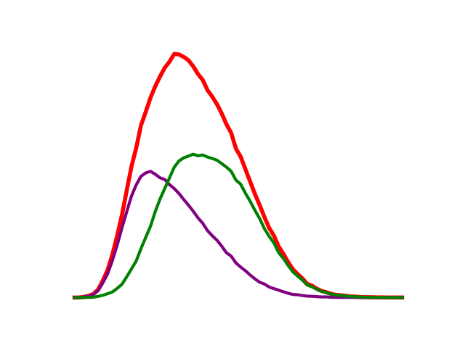
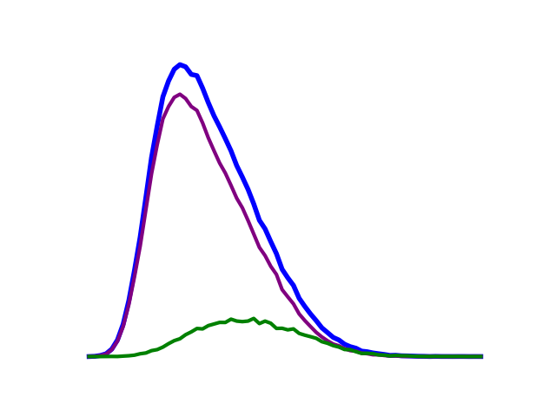
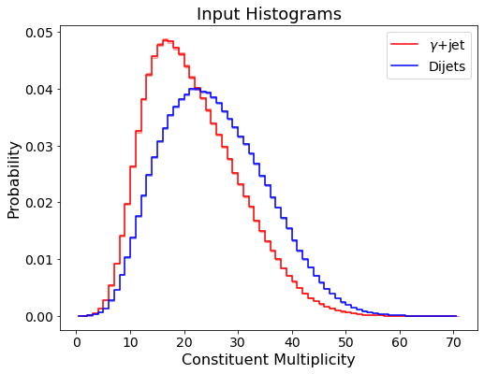
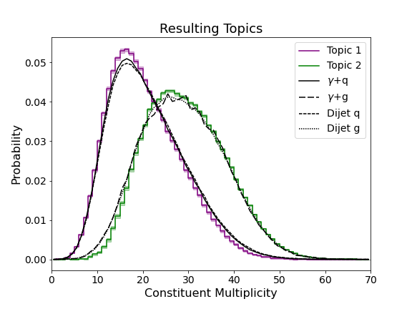
What have I worked on?
2020-2022
MIT/CERN
Quarks
Gluons
Machine
Learning!

Slide 9
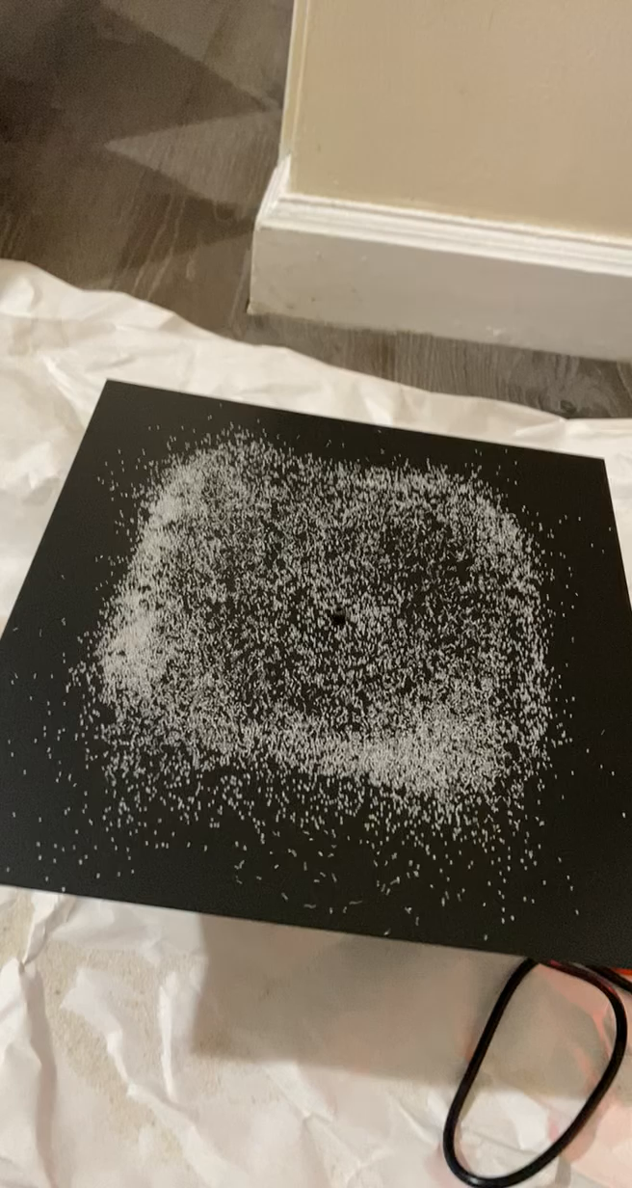
What have I worked on?
2021-2022
Arabesques
NFT art project with inspiration from physics

Slide 10
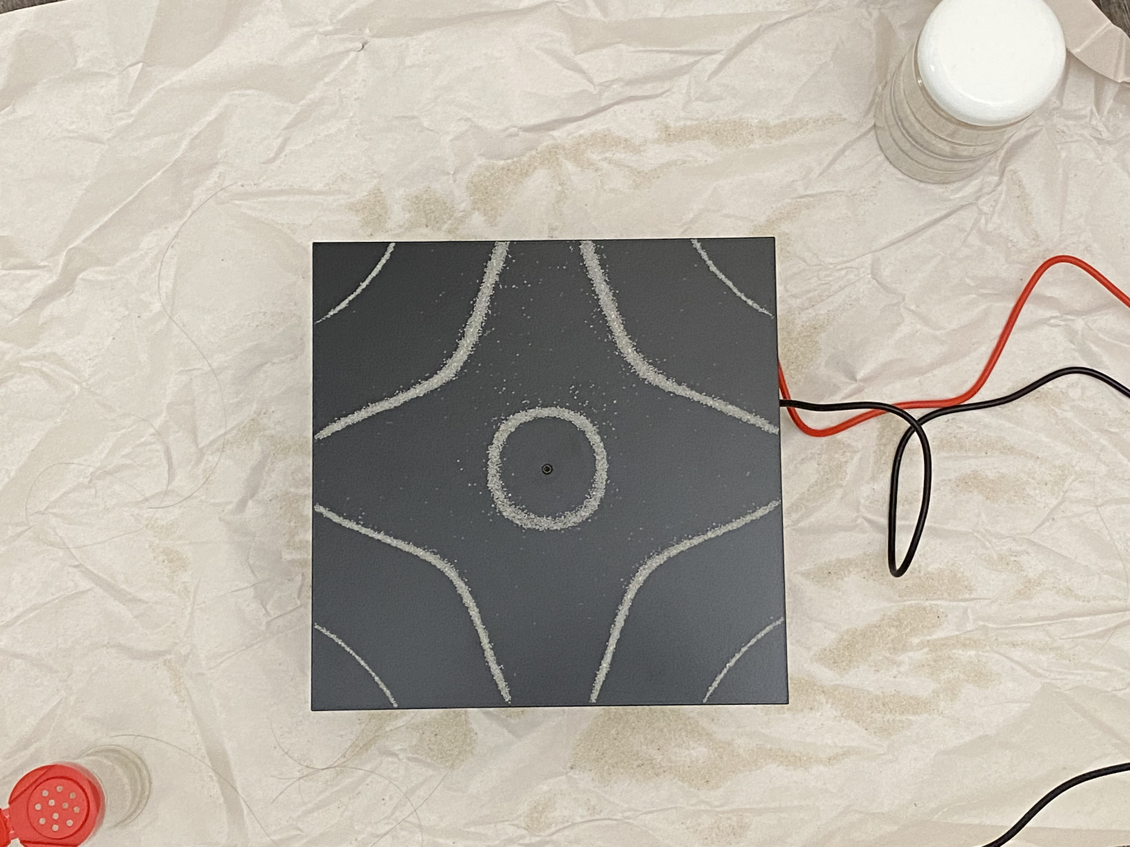

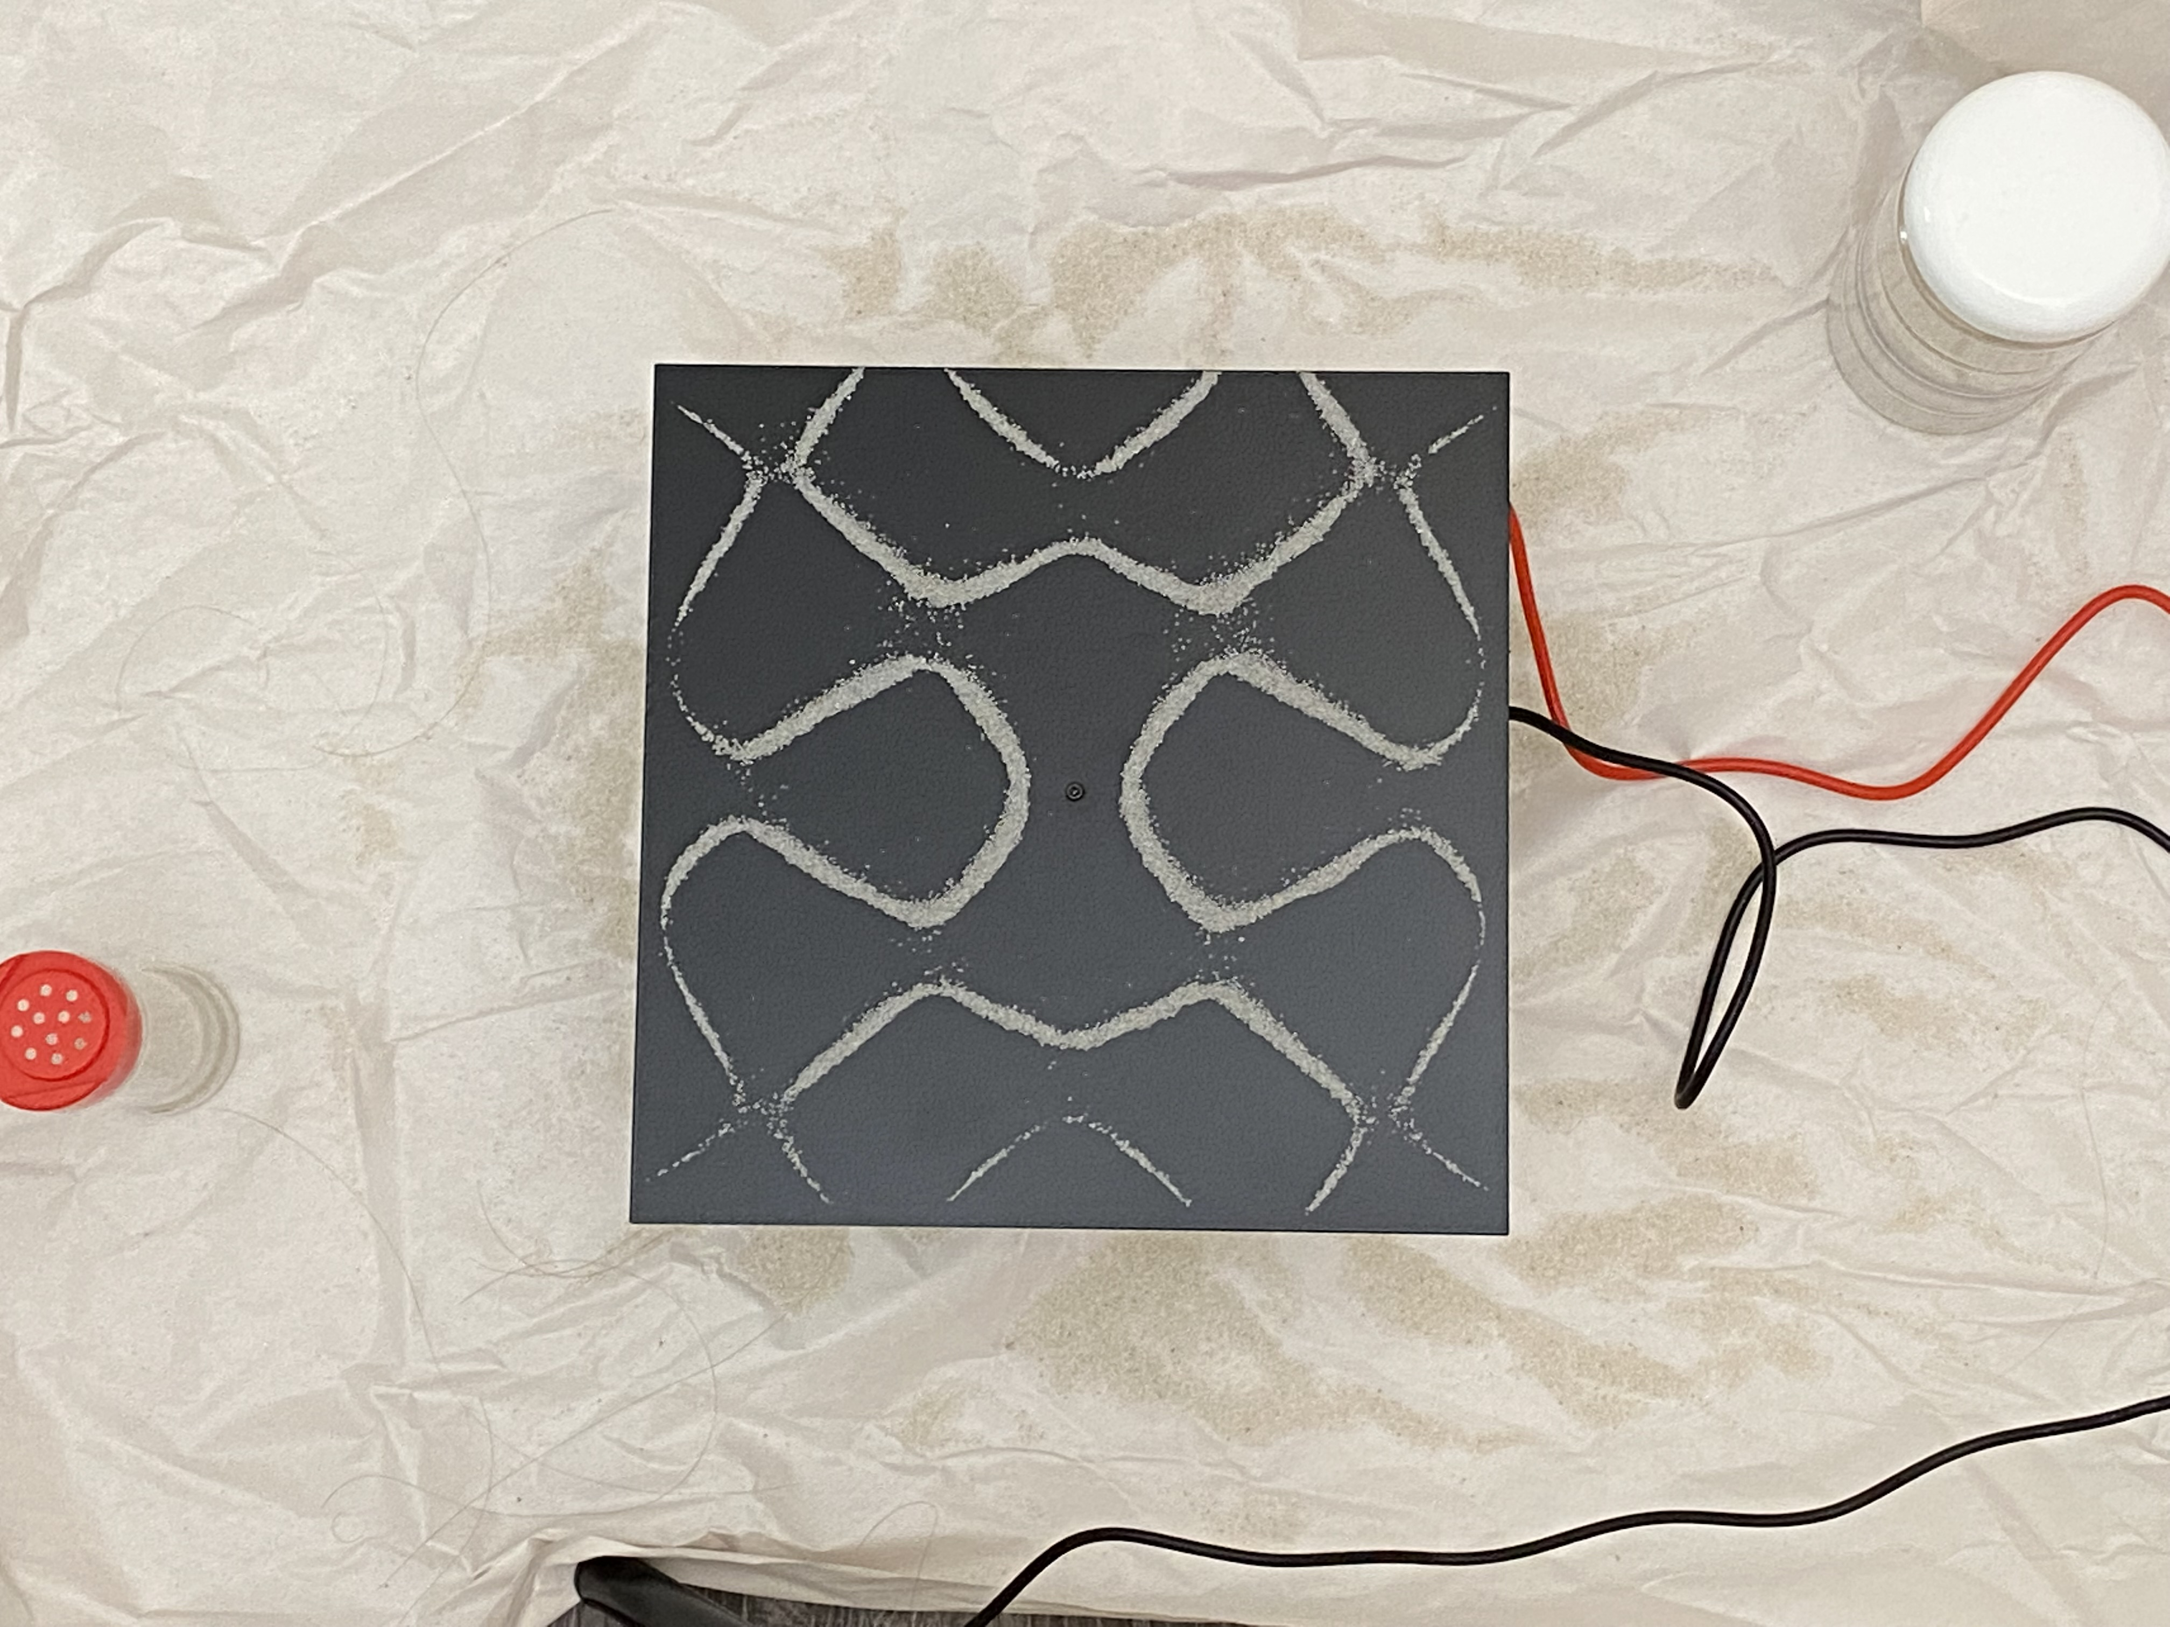

What have I worked on?
2021-2022
Arabesques
NFT art project with inspiration from physics

Slide 11






What have I worked on?
2021-2022
Arabesques
NFT art project with inspiration from physics

Slide 12
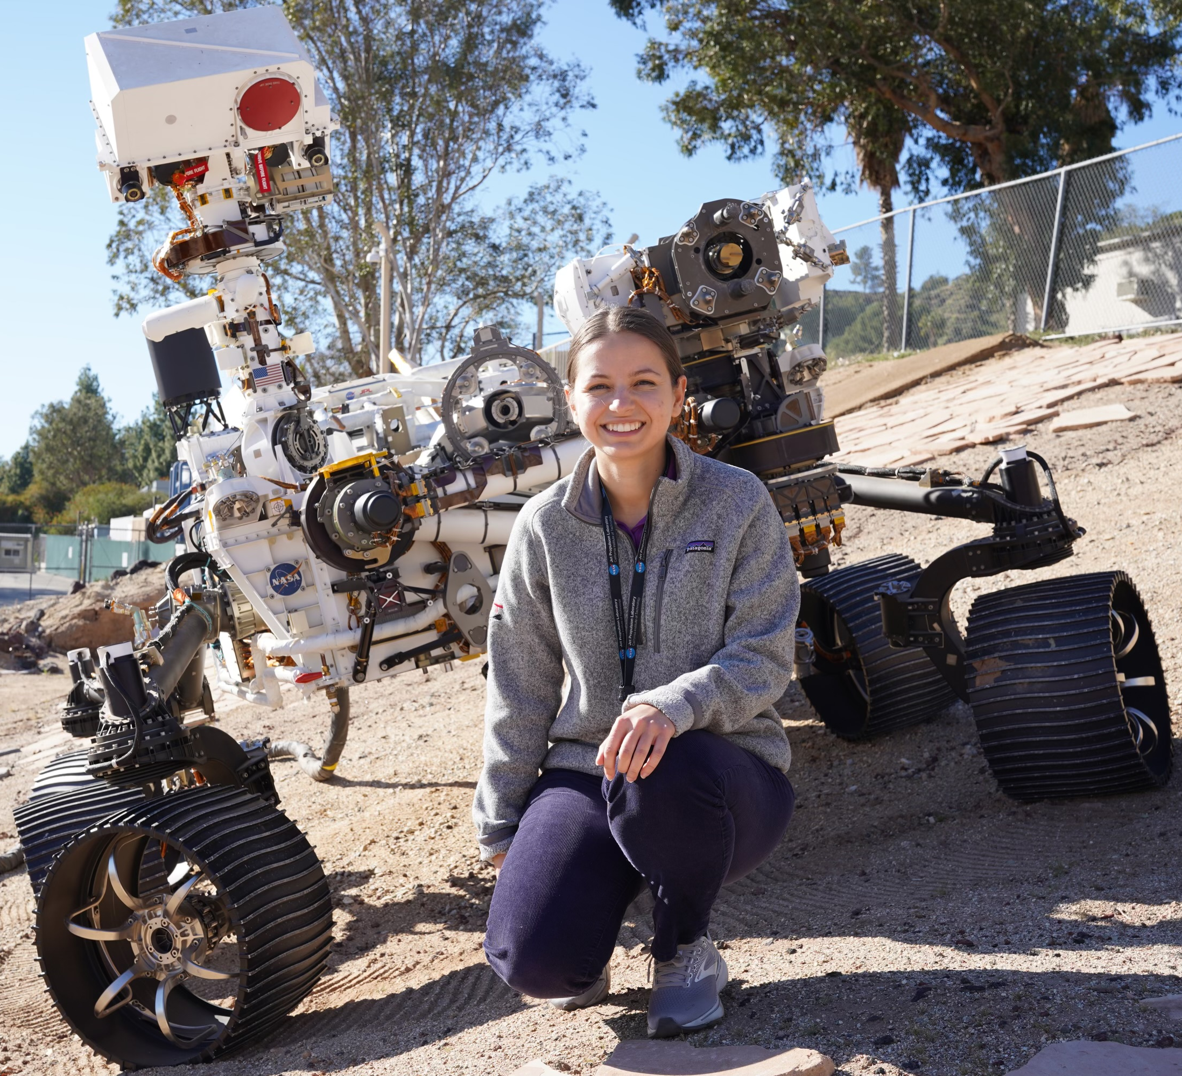
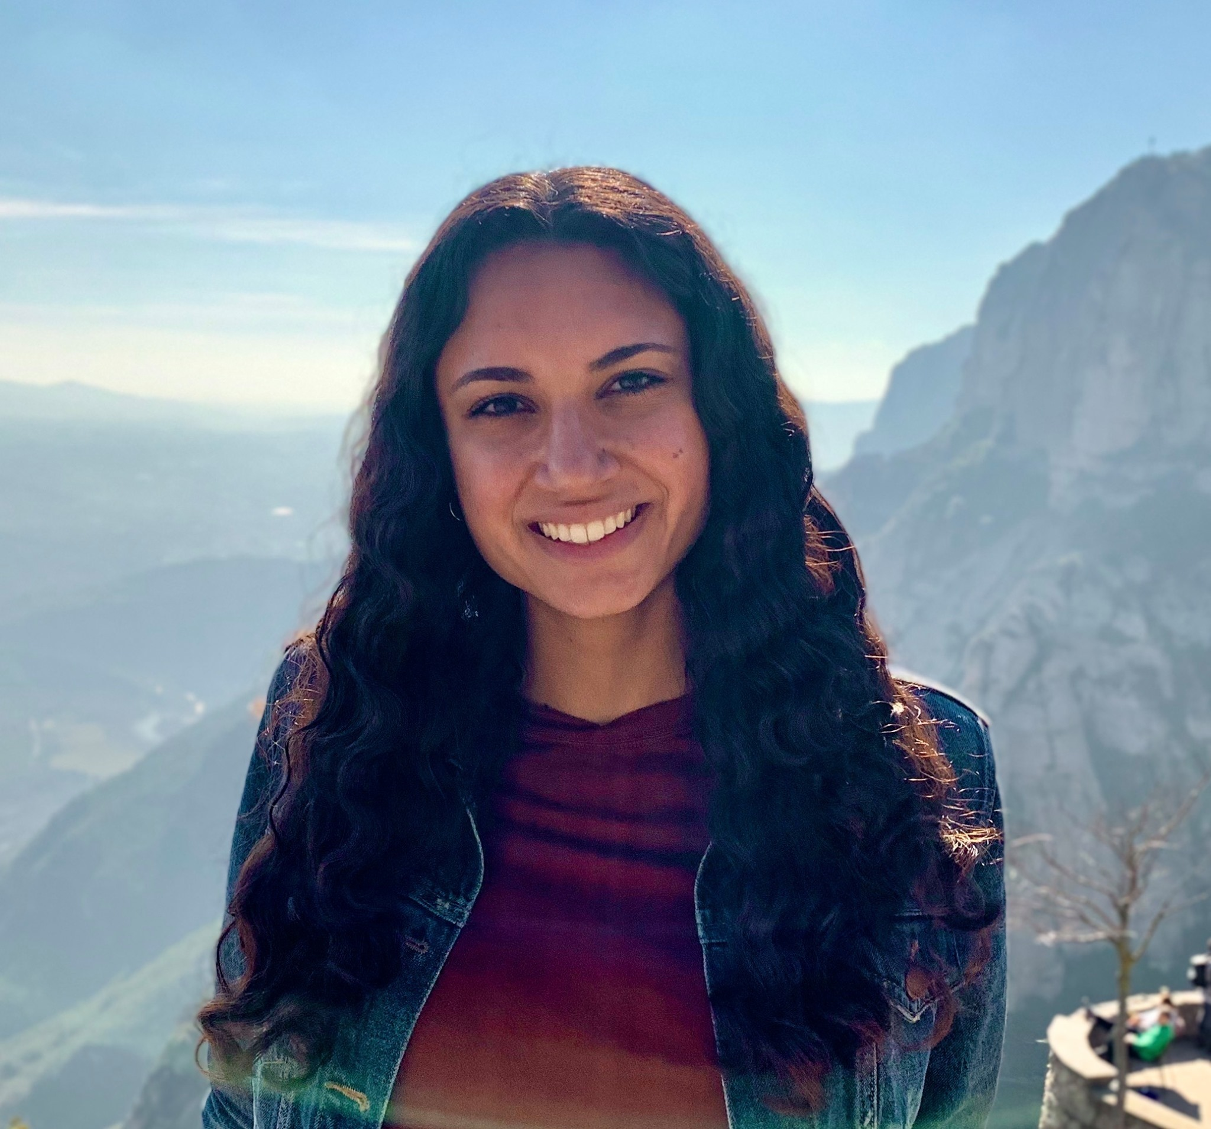
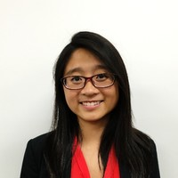
What about my friends?
Nadya Balabanska
NASA JPL
Anna Bair
CMU PHD Student
Allison Tam
Google Deepmind
Notes:
Nads – drives the rover. Rover planner, write code that gets executed by the rover everyday to do the drive and arm activities. Work on development for ground command tools
Anna - research on deep learning and understanding how neural nets work

Slide 13
Ok enough about me…
Let’s talk programming

Slide 14

What is the goal of this course?
To learn to program
Uses thinking skills from math, engineering, and science!
To learn to problem solve
We will be learning how to program using Python!
Notes:
Ask if anyone has any ideas
Math – formal languages to denote ideas
Engineers – design things using systems, evaluating tradeoffs
Scientists – observe behaviors, dev hypotheses, test predictions

Slide 15



Who knows another language?

Slide 16
Who thinks they could write a book in that language?
Notes:
Maybe you don’t know the language well enough
Maybe you don’t have ideas for a book to write!
Programming is the same idea ☺ Often, it’s the ideas behind the programs that count! Languages are interchangeable as long as you can figure out the syntax.
Note-taking: it’s fine, but just like languages, you learn more by doing! If you think note taking helps, go ahead, but I will have lecture notes and online materials available for you ☺ Personally, I believe that with coding, practice and repetition are the most useful. So, I would just pay attention!

Slide 17
The core of programming
Program (or script) – sequence of instructions that specifies how to perform a computation
Basic instructions:
Input – getting data from keyboard, file, network, etc.
Output – display data on the screen, save it somewhere, send it somewhere, etc.
Math – basic math like addition, multiplication
Conditional execution – checking for conditions and following the appropriate path
Repetition – perform some action repeatedly

Slide 18

The core of programming
Program (or script) – sequence of instructions that specifies how to perform a computation
Basic instructions:
Input – getting data from keyboard, file, network, etc.
Output – display data on the screen, save it somewhere, send it somewhere, etc.
Math – basic math like addition, multiplication
Conditional execution – checking for conditions and following the appropriate path
Repetition – perform some action repeatedly

Slide 19
Programming for the course
(pun intended)

Slide 20
Lectures
Daily, 2:45 – 5:15 PM ET
Format:
Review game (if applicable)
Lecture
Break
Practice!

Slide 21
Questions
Feel free to interrupt and ask questions about the material during lecture
Alternatively, we will have a Google doc where you can anonymously ask questions (tutors will interrupt lecture and ask questions, or answer directly on the doc)

Slide 22
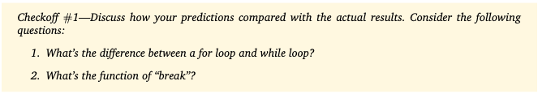
assignments
7 problem sets (referred to as psets)
First pset due Monday!
Each pset has checkoffs, where after you finish the pset, you discuss the question with staff (in-class, OH)
Final project – can choose from 5 staff-prepared projects, or choose your own idea (keep that in mind!)

Slide 23
Office hours
M-F 8:30-9:30 PM EST
This is a time for you to get help with homework, get checkoffs, or ask questions!
A lot of the concepts are brand new and difficult to grasp, there is no shame in asking for help ☺

Slide 24
Discord
We will be using a Discord server for most of our communications!
#cs-homework-help is for questions about the homeworks
#cs-tech-support is if you need setting up any software on your laptop
You can tag @CS-Staff and it will notify me and all the tutors

Slide 25
collaboration
Collaboration is encouraged, BUT you must write your answers and code yourself
Make note of who you collaborate with on the homework assignments
Do not copy from anyone or from the internet
No grades in WTP! You get out of it what you put in!

